Slide 1



Title
Shopping Management System
Francis xavier engineering college
Subikson M
95072312166

Slide 2

Introduction
Introduction:
The Shopping Management System is a Java Swing application integrated with MySQL, designed to streamline online shopping operations. It provides user authentication, product management, and order processing functionalities for both customers and administrators.
Purpose:
The system aims to automate shopping processes, manage inventory efficiently, and enhance user experience through order tracking and invoice generation.
Objectives:
Enable secure user registration and login
Facilitate product listing and stock management
Process orders with real-time updates and delivery tracking

Slide 3


Problem Statement
Running a shop the old-fashioned way causes lots of headaches. Workers often lose track of what's in stock, leading to wrong orders and unhappy customers. People can't check where their orders are or when they'll arrive, which frustrates everyone. The paper receipts and handwritten records often have mistakes and make accounting difficult. Plus, keeping customer information safe becomes a real challenge. That's why we're building this digital shopping system - to fix these problems by keeping perfect track of inventory, processing orders smoothly, and protecting everyone's information.

Slide 4

Technologies Used
Frontend: Java Swing (GUI), Java AWT
• Backend: MySQL (Database), JDBC (Java Database Connectivity)
• Libraries Used: Java Swing, Java AWT, JDBC, MySQL Connector
•Other Technologies: Multi-threading, Exception Handling, Object-Oriented Programming (OOP

Slide 5

DATABASE DESIGN
Users: Stores customer/admin accounts with login credentials and personal details, linking to orders and carts.
Products: Contains item details, prices, and stock levels, organized by categories and linked to orders.
Orders: Records transactions with status, totals, and shipping info, connected to users and order items.
Order_Items: Lists products in each order with quantities and prices, bridging orders and products.
Payments: Tracks transaction details, amounts, and statuses for each order.
Shopping_Cart: Temporarily holds products before checkout, linked to users.

Slide 6
EATURES & MODULES
1. User Management Module
2. Product Management Module
3. Order Processing Module
4. Payment Module
5. Reporting & Analytics Module
6. Admin Dashboard

Slide 7
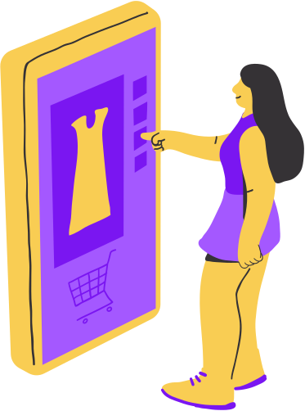
IMPLEMENTATION
Load MySQL JDBC Driver: Class.forName("com.mysql.cj.jdbc.Driver");
• Establish Connection: Connection conn =DriverManager.getConnection(URL, USER, PASSWORD);
• Close Connection: conn.close();

Slide 8
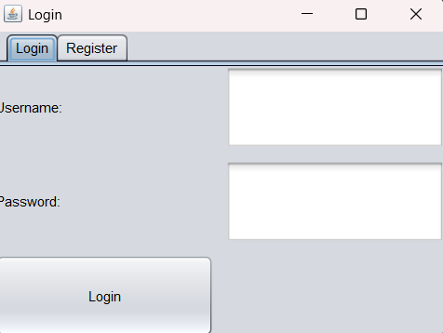
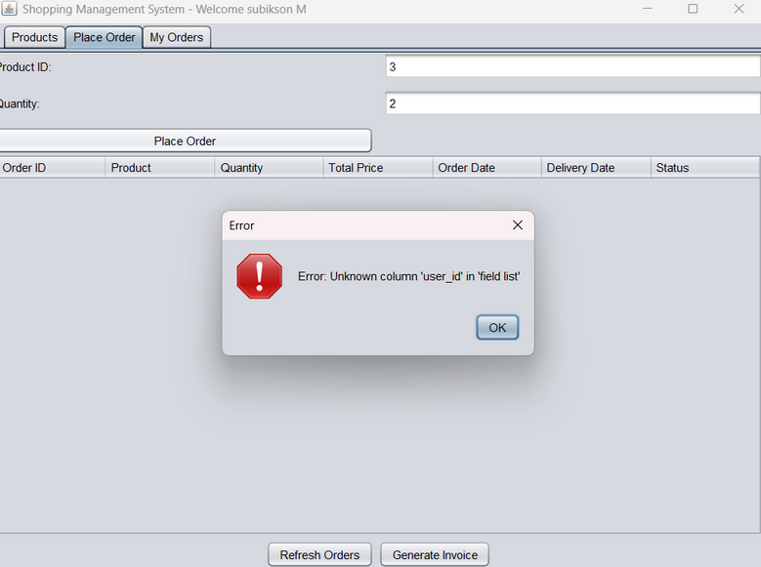
Output

Slide 9
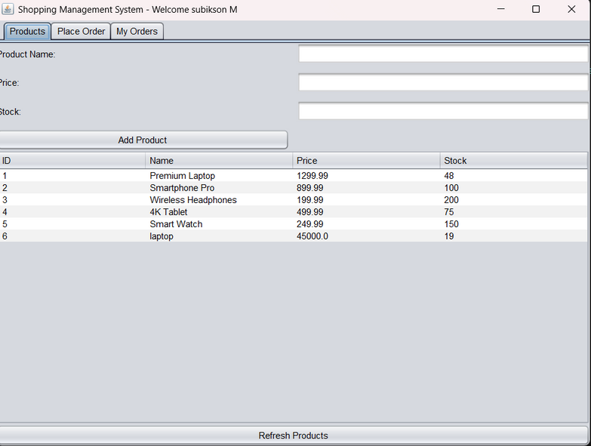
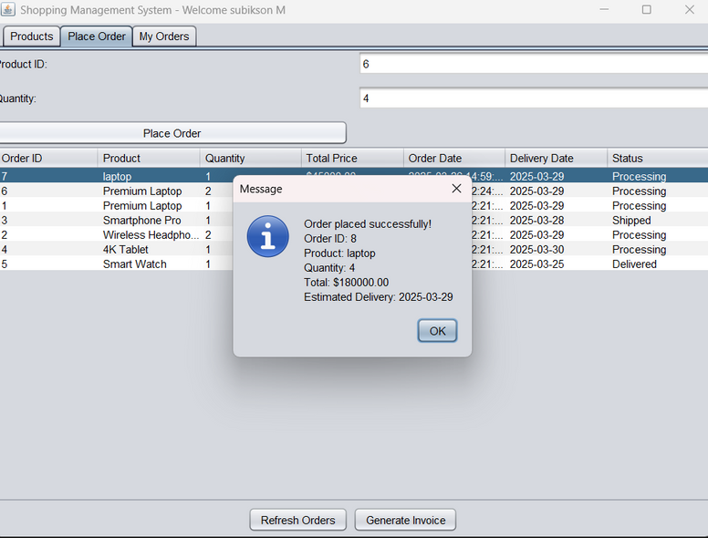
Output

Slide 10
Thank You !

